Slide 1

Development of Software for Parameter Estimation and its Application on Wind Power Plant Equivalent Model
Gabriel José Negrelli Gomes
Advisor: Prof. Dr. Elmer Pablo Tito Cari
São Carlos School of Engineering - EESC
University of São Paulo - USP

Slide 2
Introduction
Increase in renewables participation
Mainly solar and wind energy
Clean alternative to fossil fuels
Rely on weather condition

Slide 3
Introduction
Worldwide increase leaded by:
United States
China
European Union
2010 bill
Reduce greenhouse emissions by 20% (1990 levels)
20% share of renewables by 2020

Slide 4
Introduction
Brazilian Panorama:
2002 bill
Creates PROINFA
Increase wind, solar, small hydro and biomass share
Renewables supplying 10% of energy by 2024

Slide 5
Wind Energy
Wind energy benefited from these policies
European Union:
417 TWh in 2019
15% of electricity demand (1% higher than 2018)
192 GW of installed capacity (UK included)

Slide 6
Wind Energy
Source: WindEurope, 2020

Slide 7
Wind Energy
Brazil
48.5 TWh in 2018 (Itaipu: 96.5 TWh)
8.1% of electricity demand (14.4% higher than 2017)
15.5 GW of installed capacity

Slide 8
Wind Energy
Source: ABEEolica, 2020

Slide 9
Wind Energy
Brazil
Energy yield yet to be explored
Potential to generate 272 TWh
144 TWh in the Northeast Region
Complimentary regimes of wind and water (São Francisco River)

Slide 10
Wind Energy
Source: ANEEL, 2005

Slide 11
Wind Energy
Growth expectations for this source
Disadvantages:
Stochastic source
Not evenly distributed
Generators with low inertia
Affects system stability

Slide 12
Wind Energy
Study of effects of these plants on stability
Need of mathematical models
Multiple generators
Equivalent model
Source: Adapted from (MULJADI; ELLIS, 2008)

Slide 13
Research Goals
Development of software for parameter estimation
Package with estimation framework
Graphical user interface (GUI)
Application on wind power plant equivalent model

Slide 14
Wind Turbine Generators

Slide 15
Wind Turbine Generators
Huge variety of generators
Task force to develop generic models
Four types of wind turbine generators
Representation of wind power plants by one machine

Slide 16
Wind Turbine Generators
Type-1 Wind Turbine (SCIG):
Squirrel-Cage Induction Generator
Operates at constant speed
Reactive compensation

Slide 17
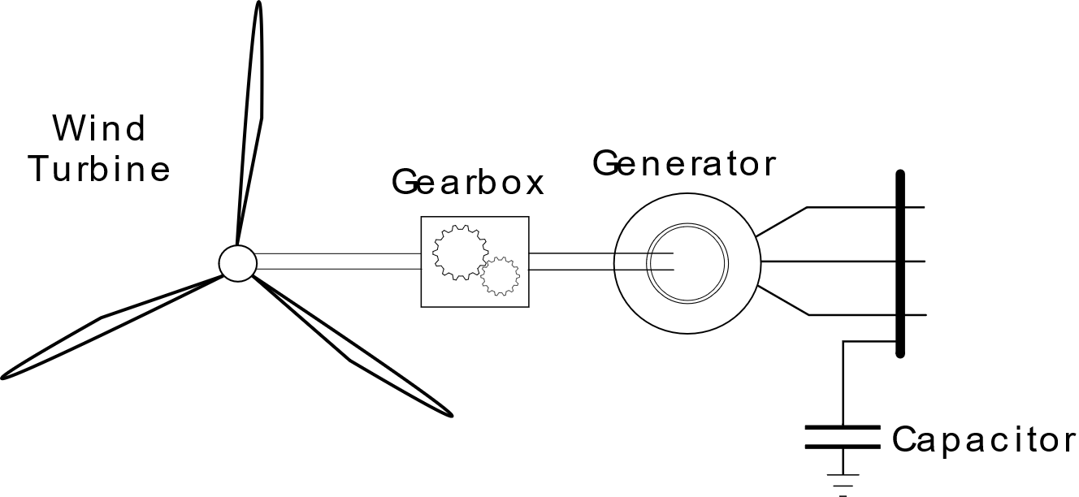
Wind Turbine Generators
Type-1 Wind Turbine (SCIG):

Slide 18
Wind Turbine Generators
Type-2 Wind Turbine (WRIG):
Wound Rotor Induction Generator
Rotor resistance variation
Reactive compensation

Slide 19
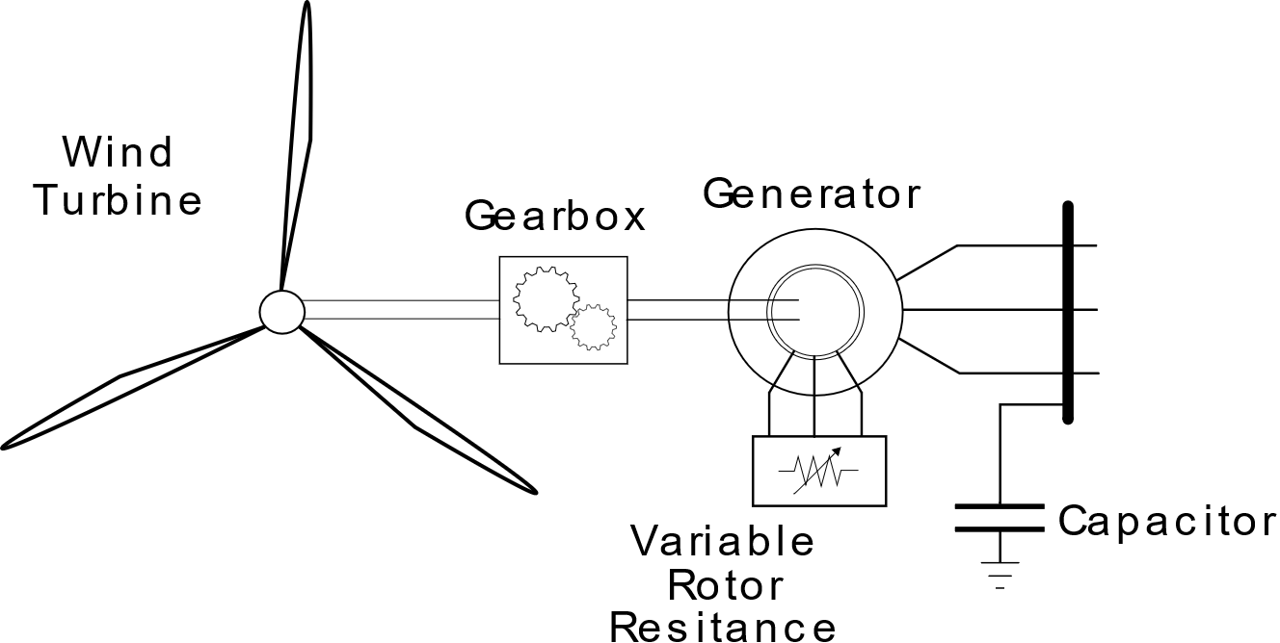
Wind Turbine Generators
Type-2 Wind Turbine (WRIG):

Slide 20
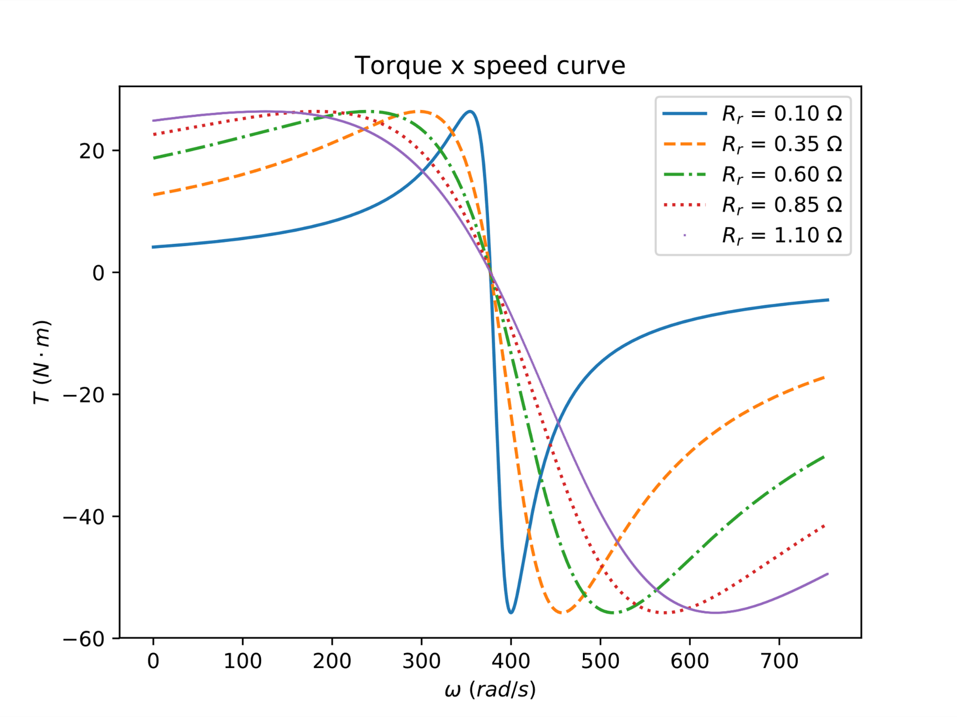
Wind Turbine Generators
Type-2 Wind Turbine (WRIG):
Alter torque-speed curve
Operates within a small speed range

Slide 21
Wind Turbine Generators
Type-3 Wind Turbine (DFIG):
Doubly Fed Induction Generator
Wound Rotor Induction Generator + frequency converter
Operates at ± 30% of rated speed
Reactive injection control

Slide 22
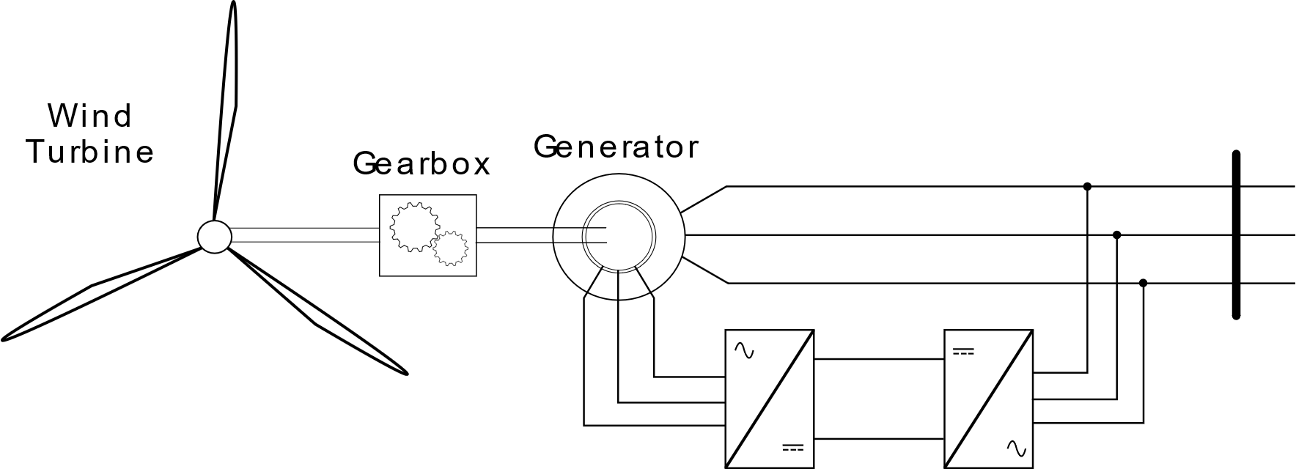
Wind Turbine Generators
Type-3 Wind Turbine (DFIG):

Slide 23
Wind Turbine Generators
Type-4 Wind Turbine:
Induction/Synchronous Generator
Grid connection through converter
Wide speed range
Reactive injection control

Slide 24
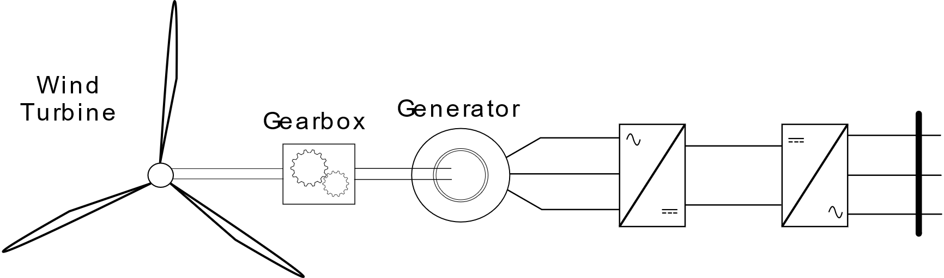
Wind Turbine Generators
Type-4 Wind Turbine:

Slide 25
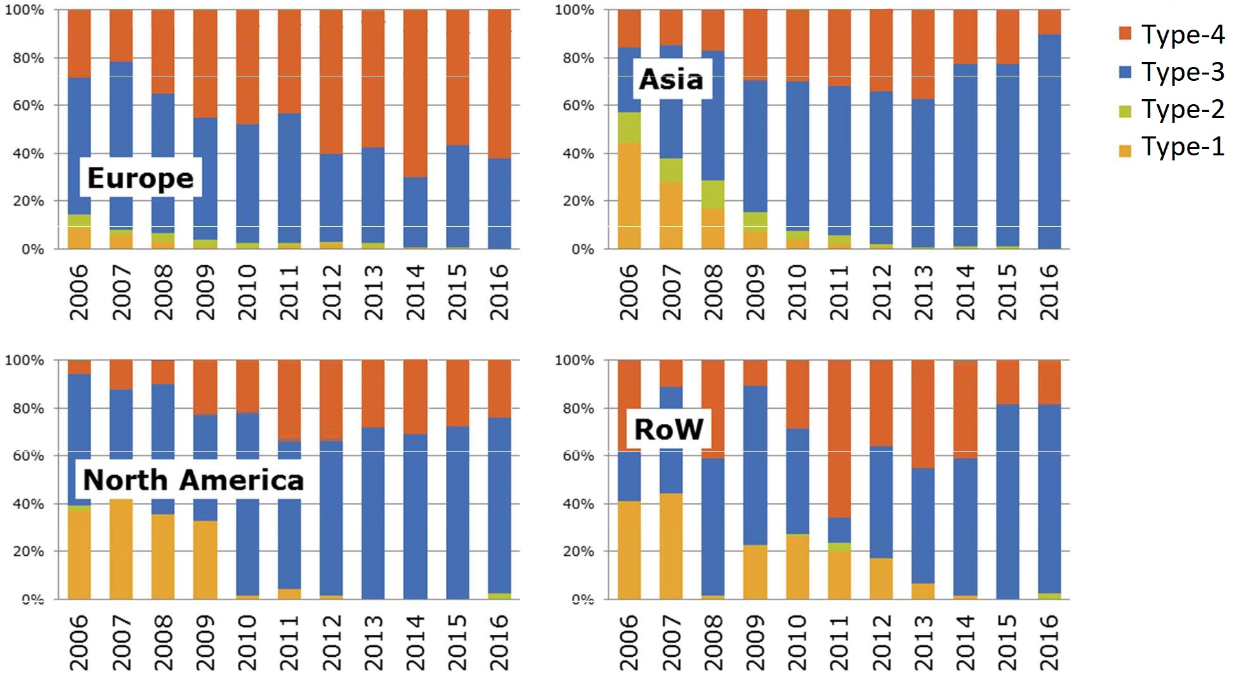
Wind Turbine Generators
Source: JRC, 2017

Slide 26
Wind Power Plant Model

Slide 27
Wind Power Plant Model
Represent Type-3 and 4 Generators
Behaviour of wind power plants
Transient studies

Slide 28
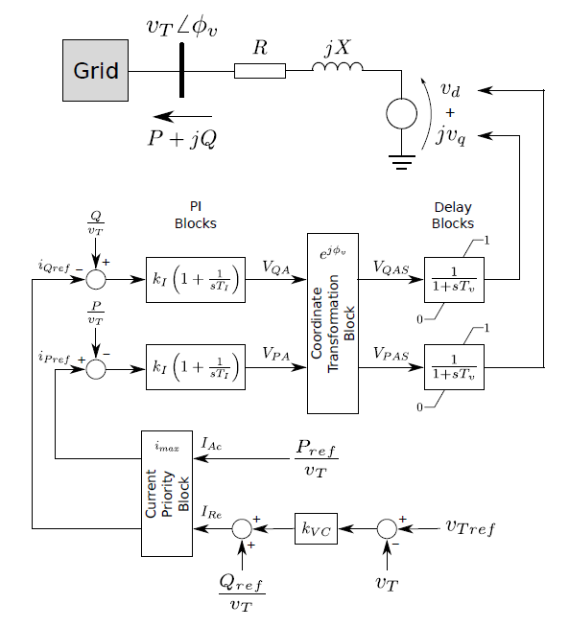
Wind Power Plant Model
Source: Adapted from (ERLICH et al., 2012)

Slide 29
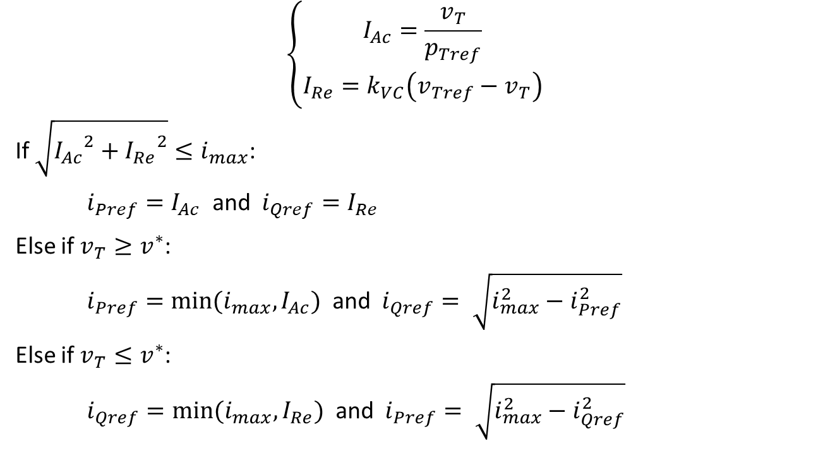
Wind Power Plant Model
$$\left\{\begin{aligned}I_{Ac}=\frac{v_{T}}{p_{Tref}} \\ I_{Re}=k_{VC}\left(v_{Tref}−v_{T}\right)\end{aligned}\right.$$
If $\sqrt{{I_{Ac}}^{2}+{I_{Re}}^{2}}≤i_{max}$:
$i_{Pref}=I_{Ac}$ and $i_{Qref}=I_{Re}$
Else if $v_{T}≥v^{∗}$:
$i_{Pref}=min⁡(i_{max}, I_{Ac})$ and $i_{Qref}= \sqrt{i_{max}^{2}−i_{Pref}^{2}}$
Else if $v_{T}≤v^{∗}$:
$i_{Qref}=min⁡(i_{max}, I_{Re})$ and $i_{Pref}= \sqrt{i_{max}^{2}−i_{Qref}^{2}}$

Slide 30
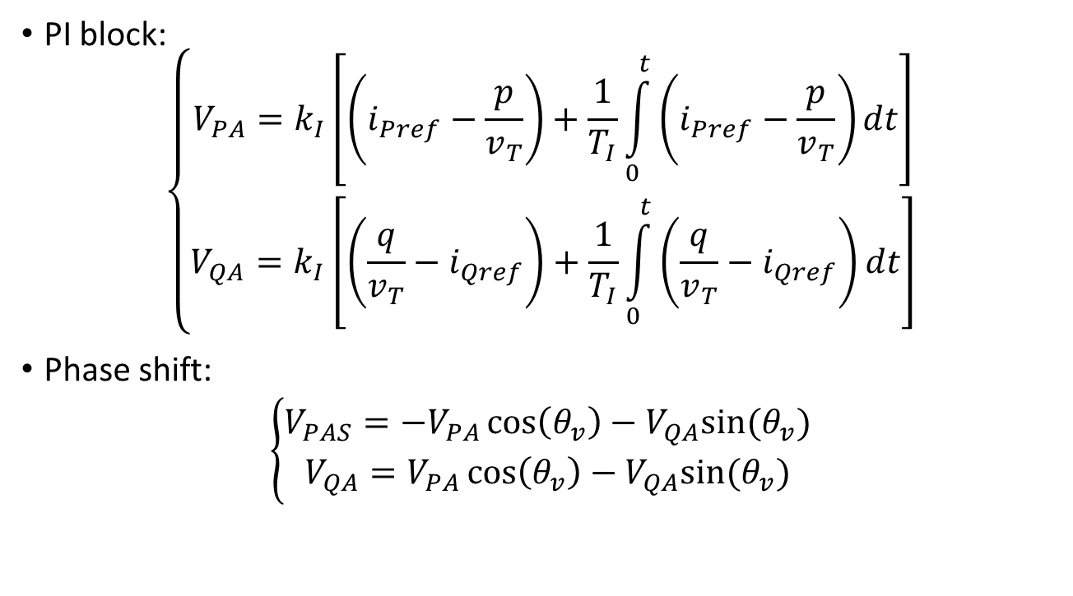
Wind Power Plant Model
PI block:
$$\left\{\begin{aligned}V_{PA}=k_{I}\left[\left(i_{Pref}−\frac{p}{v_{T}}\right)+\frac{1}{T_{I}}\int_{0}^{t}{\left(i_{Pref}−\frac{p}{v_{T}}\right)dt}\right] \\ V_{QA}=k_{I}\left[\left(\frac{q}{v_{T}}−i_{Qref}\right)+\frac{1}{T_{I}}\int_{0}^{t}{\left(\frac{q}{v_{T}}−i_{Qref}\right)dt}\right]\end{aligned}\right.$$
Phase shift:
$$\left\{\begin{aligned}V_{PAS}=−V_{PA}\cos\left(θ_{v}\right)−V_{QA}sin⁡(θ_{v}) \\ V_{QA}=V_{PA}\cos\left(θ_{v}\right)−V_{QA}sin⁡(θ_{v})\end{aligned}\right.$$

Slide 31
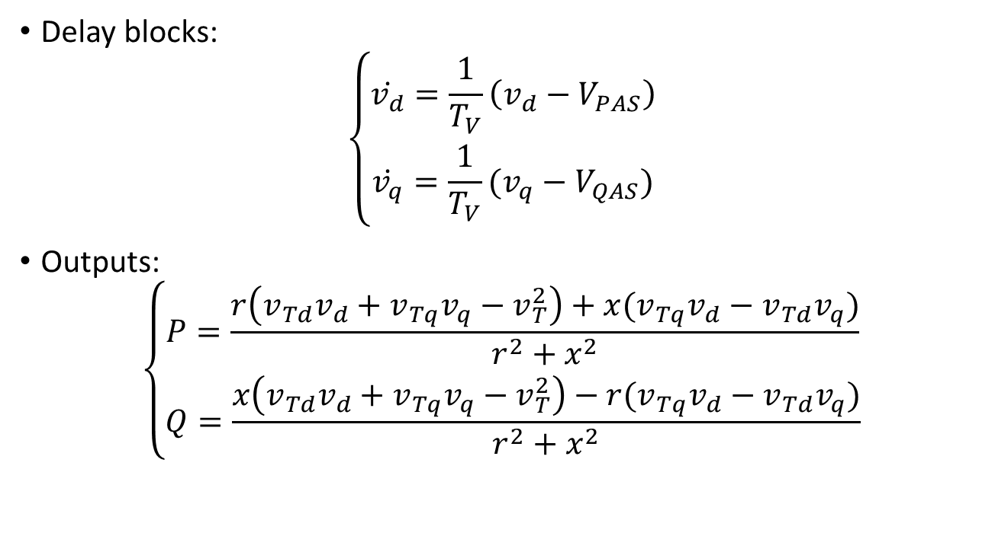
Wind Power Plant Model
Delay blocks:
$$\left\{\begin{aligned}\dot{v_{d}}=\frac{1}{T_{V}}\left(v_{d}−V_{PAS}\right) \\ \dot{v_{q}}=\frac{1}{T_{V}}(v_{q}−V_{QAS})\end{aligned}\right.$$
Outputs:
$$\left\{\begin{aligned}P=\frac{r\left(v_{Td}v_{d}+v_{Tq}v_{q}−v_{T}^{2}\right)+x(v_{Tq}v_{d}−v_{Td}v_{q})}{r^{2}+x^{2}} \\ Q=\frac{x\left(v_{Td}v_{d}+v_{Tq}v_{q}−v_{T}^{2}\right)−r(v_{Tq}v_{d}−v_{Td}v_{q})}{r^{2}+x^{2}}\end{aligned}\right.$$

Slide 32
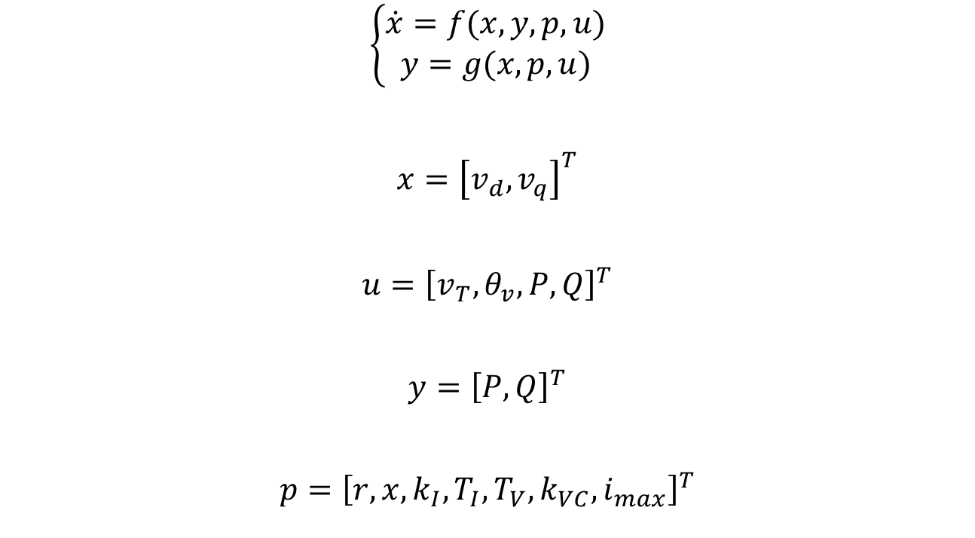
Wind Power Plant Model
$$\left\{\begin{aligned}\dot{x}=f(x,y,p,u) \\ y=g(x,p,u)\end{aligned}\right.$$
$$x={\left[v_{d}, v_{q}\right]}^{T}$$
$$u={\left[v_{T},θ_{v},P,Q\right]}^{T}$$
$$y={\left[P, Q\right]}^{T}$$
$$p={\left[r,x,k_{I},T_{I},T_{V},k_{VC}, i_{max}\right]}^{T}$$

Slide 33
Wind Power Plant Model
Represent Type-3 and -4 Generators
Behaviour of wind power plants
Transient studies
Disadvantages:
PMUs required to obtain angle measurement

Slide 34
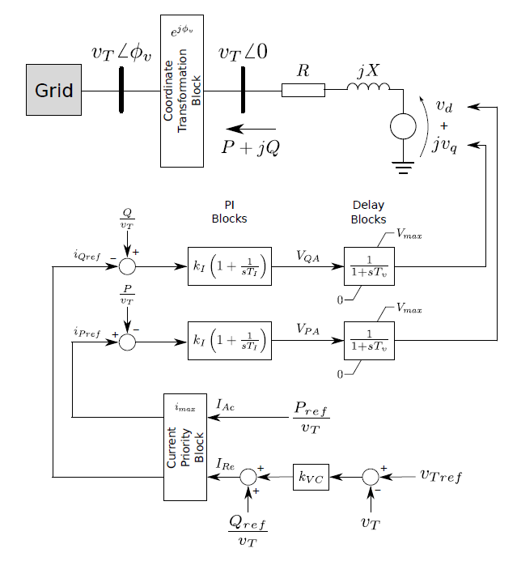
Proposed Wind Power Plant Model
Source: Adapted from (ERLICH et al., 2012)

Slide 35
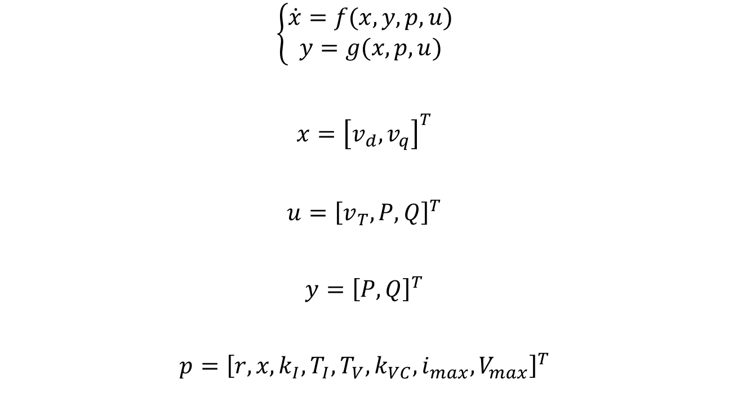
Proposed Wind Power Plant Model
$$\left\{\begin{aligned}\dot{x}=f(x,y,p,u) \\ y=g(x,p,u)\end{aligned}\right.$$
$$x={\left[v_{d}, v_{q}\right]}^{T}$$
$$u={\left[v_{T}, P,Q\right]}^{T}$$
$$y={\left[P, Q\right]}^{T}$$
$$p={\left[r,x,k_{I},T_{I},T_{V},k_{VC},i_{max},V_{max}\right]}^{T}$$

Slide 36
Parameter Estimation Method

Slide 37
Parameter Estimation Method

Slide 38
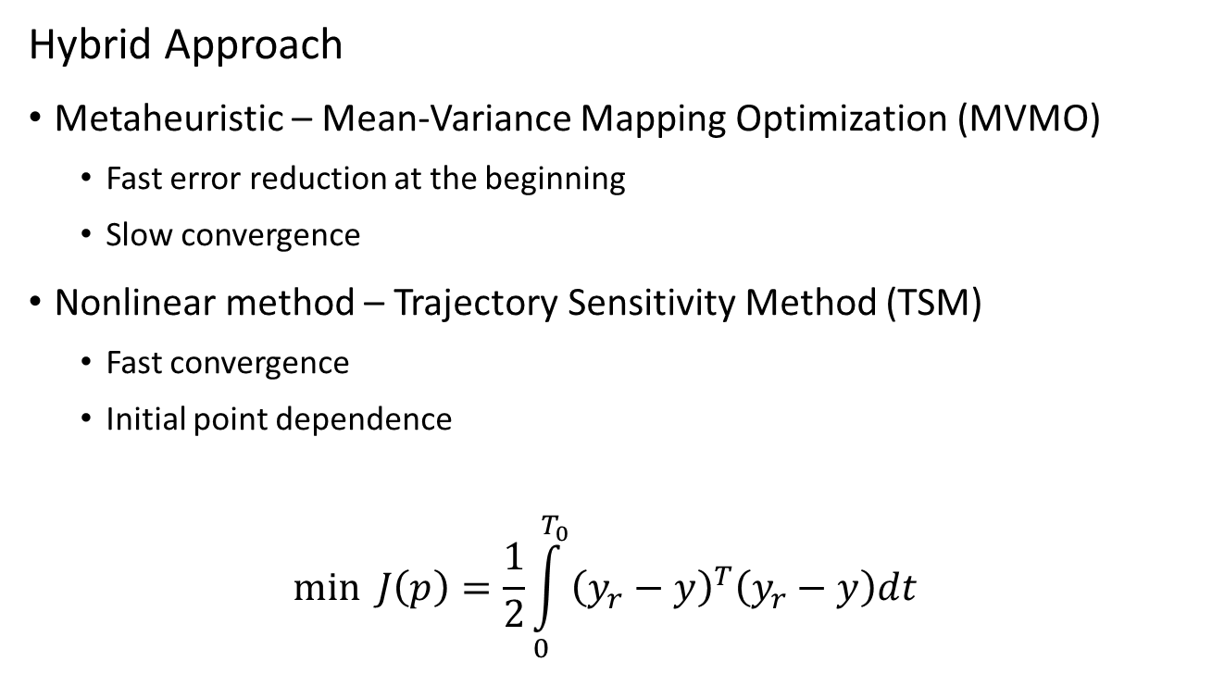
Parameter Estimation Method
Hybrid Approach
Metaheuristic – Mean-Variance Mapping Optimization (MVMO)
Fast error reduction at the beginning
Slow convergence
Nonlinear method – Trajectory Sensitivity Method (TSM)
Fast convergence
Initial point dependence
$$\min{J\left(p\right)=\frac{1}{2}\int_{0}^{T_{0}}{{\left(y_{r}−y\right)}^{T}\left(y_{r}−y\right)dt} }$$

Slide 39
MVMO
Population-based metaheuristic
Offspring considering population statistics
Great results for small populations

Slide 40
MVMO
Setup
Population size
Number of offspring
Number of genes for mutation
Selection method
Normalized search region

Slide 41




MVMO
Best
Worst

Slide 42
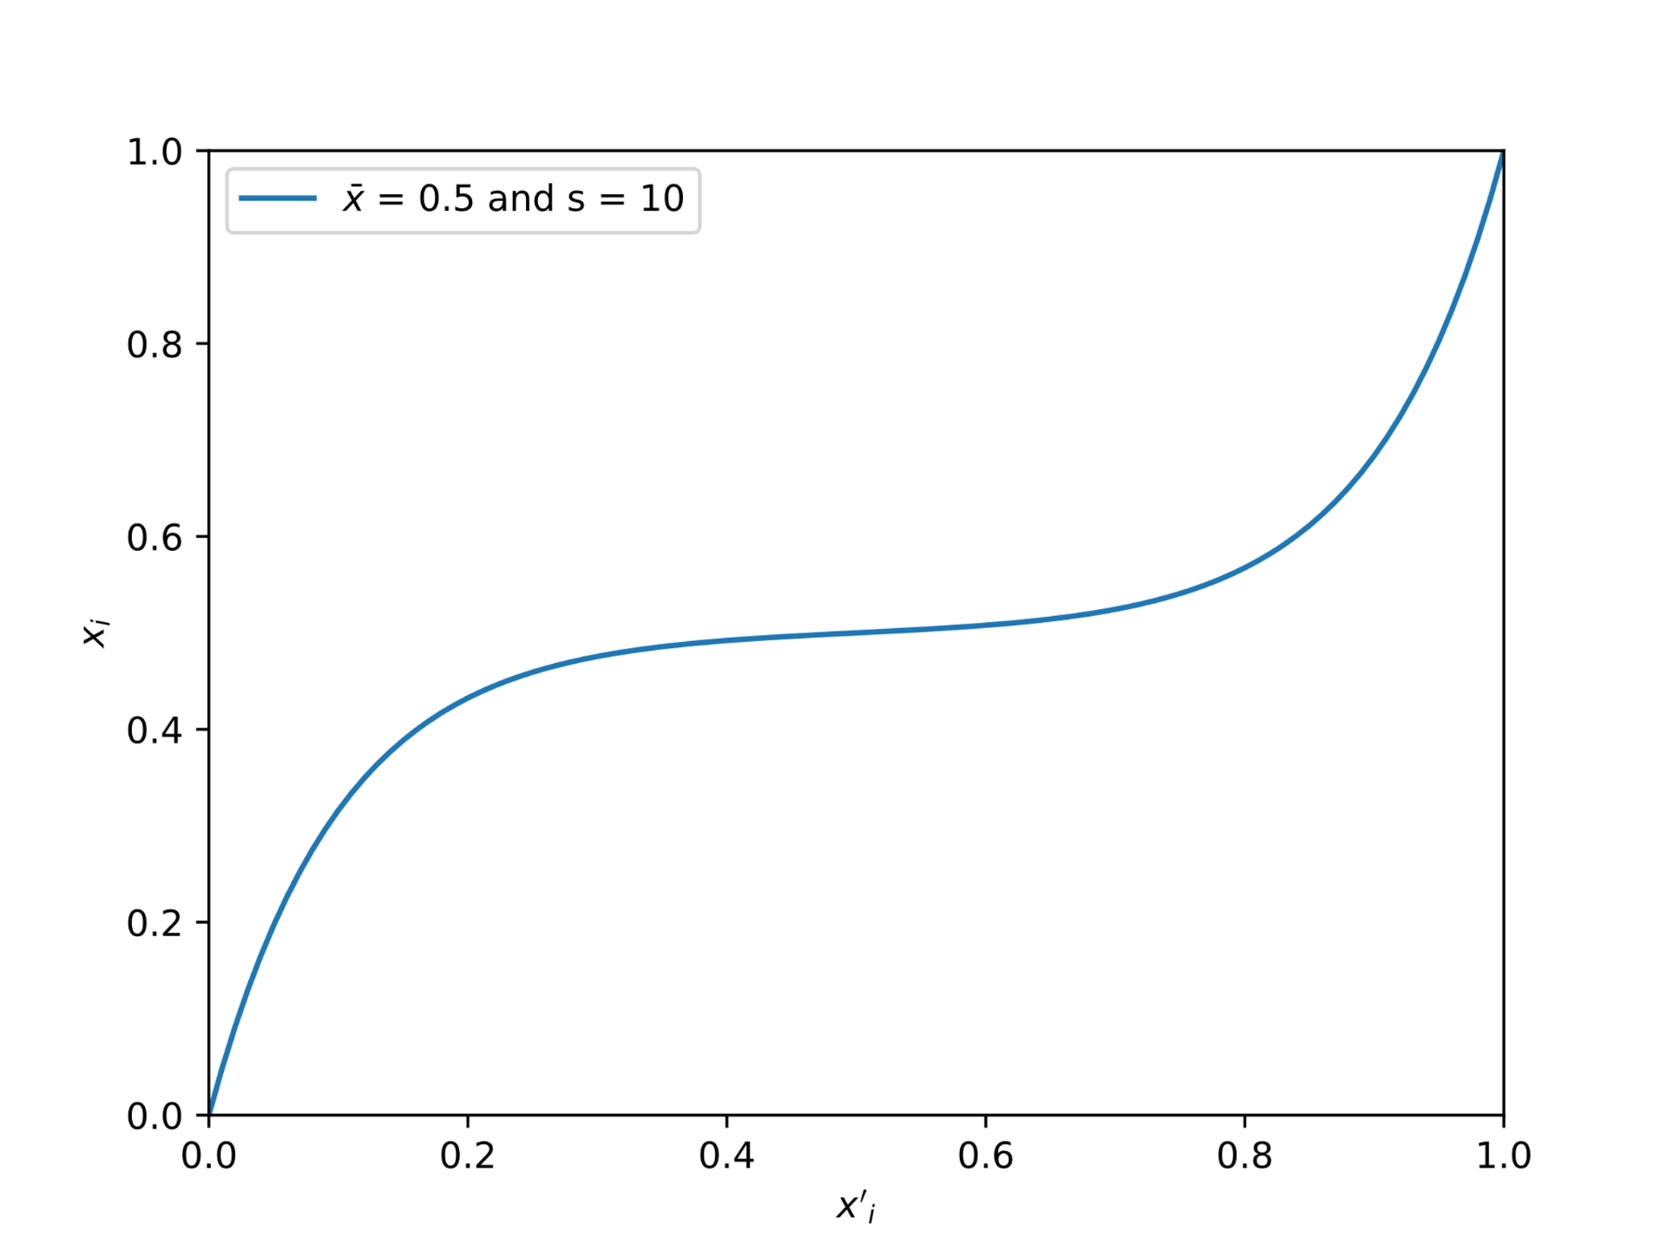
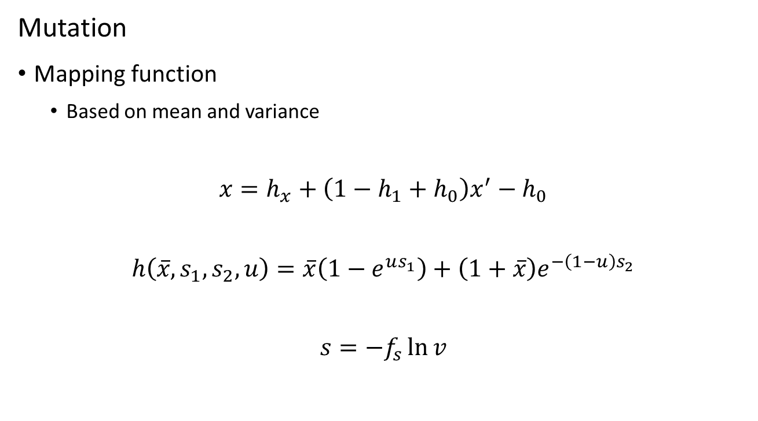
MVMO
Mutation
Mapping function
Based on mean and variance
$$x=h_{x}+\left(1−h_{1}+h_{0}\right)x^{′}−h_{0}$$
$$h\left(\overline{x},s_{1},s_{2},u\right)=\overline{x}\left(1−e^{us_{1}}\right)+\left(1+\overline{x}\right)e^{−\left(1−u\right)s_{2}}$$
$$s=−f_{s}\ln{v}$$

Slide 43
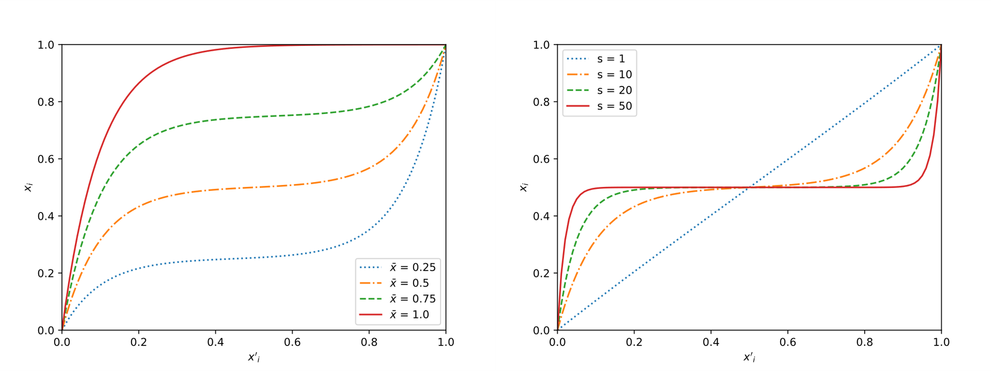
MVMO
Mean and variance effects

Slide 44
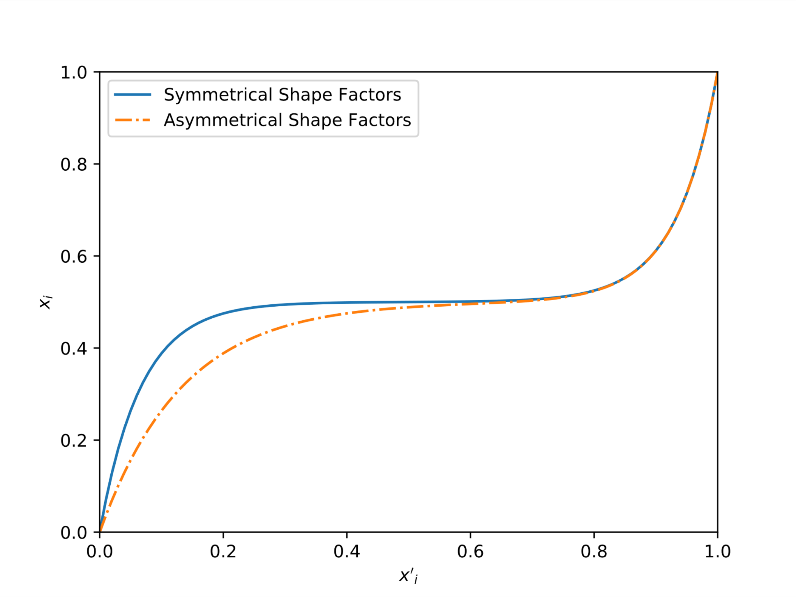
MVMO
Asymmetrical shape factors

Slide 45
TSM
Based on Newton-Raphson
Fast convergence
Initial values dependence

Slide 46
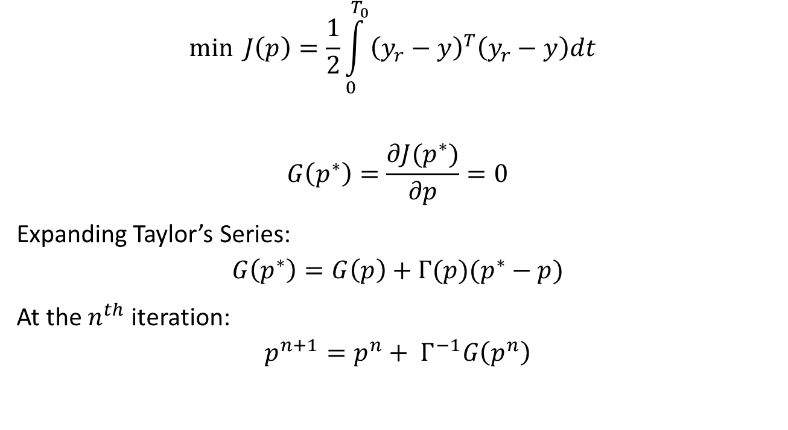
TSM
$$\min{J\left(p\right)=\frac{1}{2}\int_{0}^{T_{0}}{{\left(y_{r}−y\right)}^{T}\left(y_{r}−y\right)dt} }$$
$$G\left(p^{∗}\right)=\frac{∂J(p^{∗})}{∂p}=0$$
Expanding Taylor’s Series:
$$G\left(p^{∗}\right)=G\left(p\right)+Γ(p)(p^{∗}−p)$$
At the $n^{th}$ iteration:
$$p^{n+1}=p^{n}+ Γ^{−1}G\left(p^{n}\right)$$

Slide 47
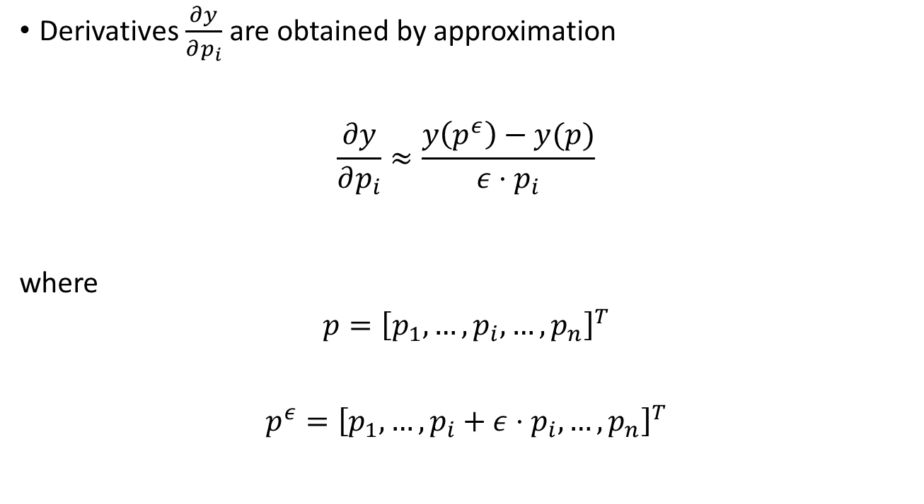
TSM
Derivatives $\frac{∂y}{∂p_{i}}$ are obtained by approximation
$$\frac{∂y}{∂p_{i}}≈\frac{y\left(p^{ε}\right)−y(p)}{ε⋅p_{i}}$$
where
$$p={\left[p_{1},…,p_{i},…,p_{n}\right]}^{T}$$
$$p^{ε}={\left[p_{1},…,p_{i}+ε⋅p_{i},…,p_{n}\right]}^{T}$$

Slide 48
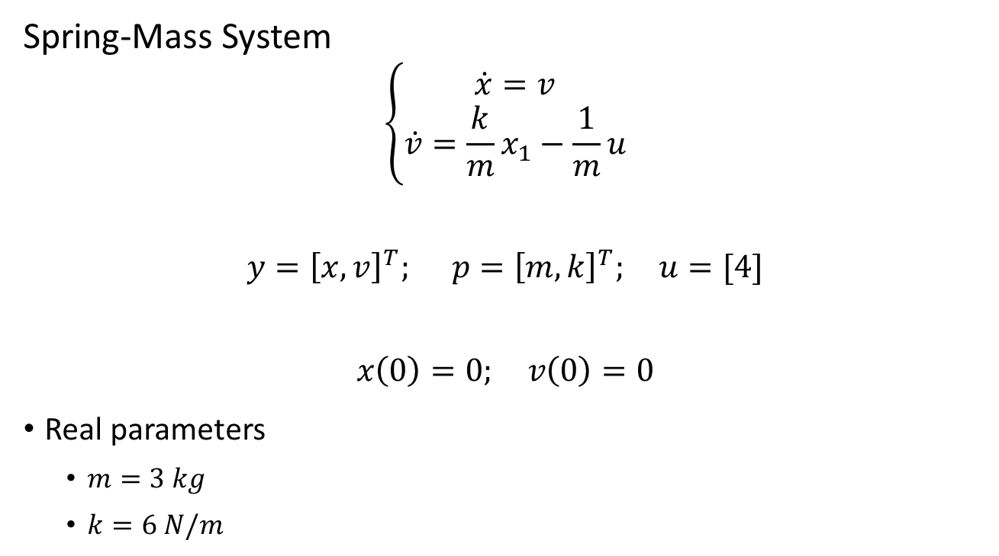
Hybrid Method Application
Spring-Mass System
$$\left\{\begin{aligned}\dot{x}=v \\ \dot{v}=\frac{k}{m}x_{1}−\frac{1}{m}u\end{aligned}\right.$$
$$y={\left[x,v\right]}^{T}; p={\left[m,k\right]}^{T}; u=[4]$$
$$x\left(0\right)=0; v\left(0\right)=0$$
Real parameters
$m=3 kg$
$k=6 N/m$

Slide 49
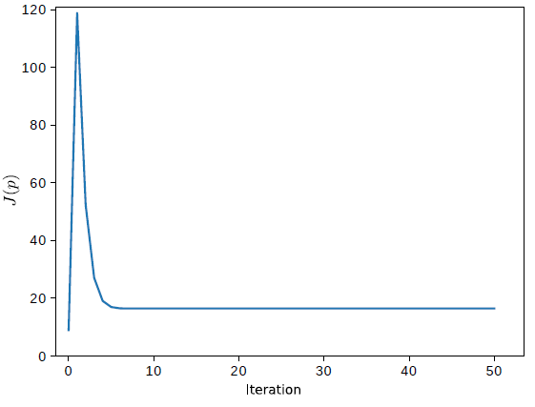
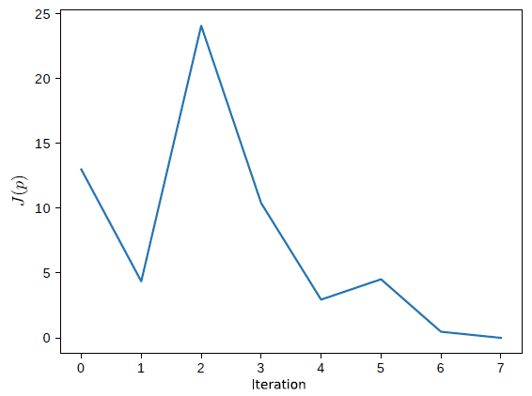
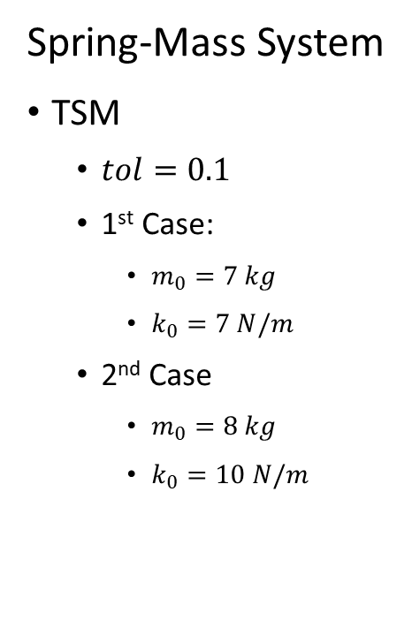
Hybrid Method Application
Spring-Mass System
TSM
$tol=0.1$
1st Case:
$m_{0}=7 kg$
$k_{0}=7 N/m$
2nd Case
$m_{0}=8 kg$
$k_{0}=10 N/m$

Slide 50
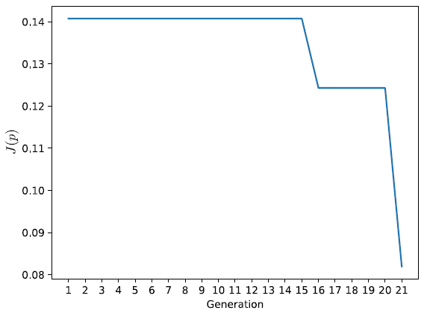
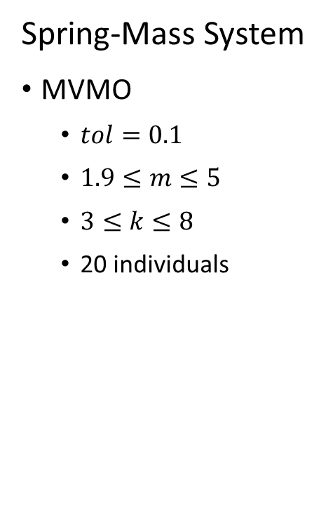
Hybrid Method Application
Spring-Mass System
MVMO
$tol=0.1$
$1.9≤m≤5$
$3≤k≤8$
20 individuals

Slide 51
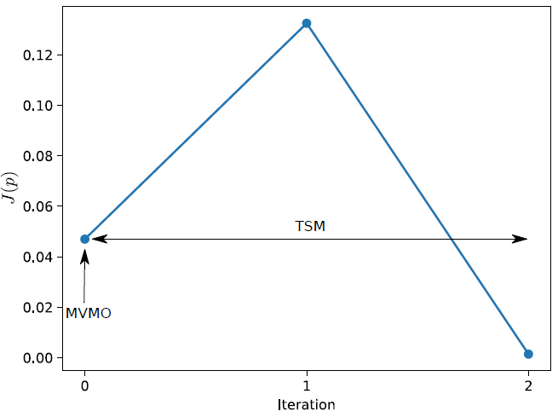
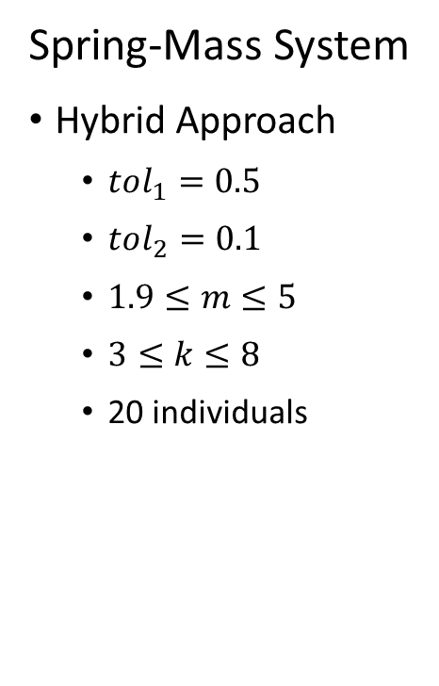
Hybrid Method Application
Spring-Mass System
Hybrid Approach
$tol_{1}=0.5$
$tol_{2}=0.1$
$1.9≤m≤5$
$3≤k≤8$
20 individuals

Slide 52
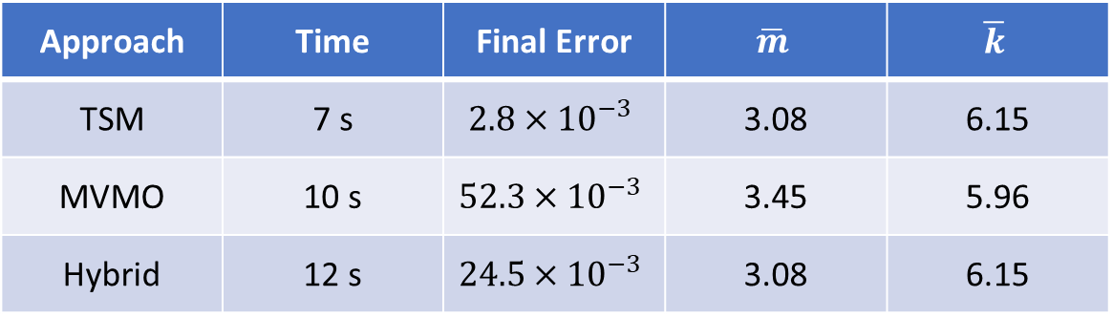
Hybrid Method Application
Approach | Time | Final Error | $$\overline{m}$$ | $$\overline{k}$$
TSM | 7 s | $$2.8×{10}^{−3}$$ | 3.08 | 6.15
MVMO | 10 s | $$52.3×{10}^{−3}$$ | 3.45 | 5.96
Hybrid | 12 s | $$24.5×{10}^{−3}$$ | 3.08 | 6.15

Slide 53
Software Developed

Slide 54
Software
identPy:
Framework for parameter estimation
identPy_GUI:
Graphical User Interface for framework
Python
Non-specific

Slide 55
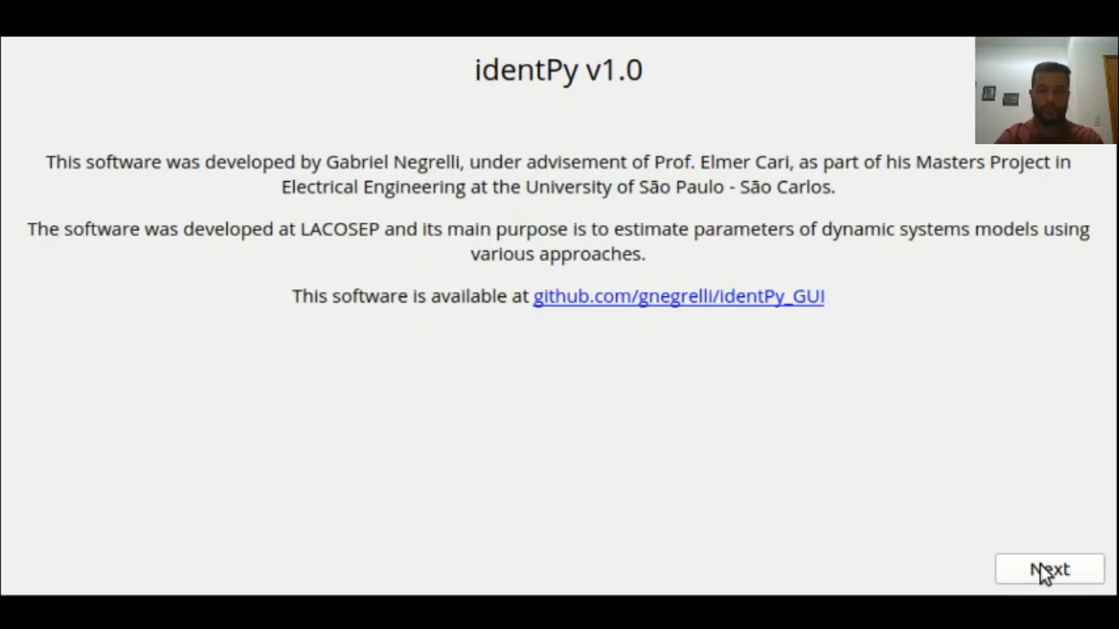
Software

Slide 56
Results

Slide 57
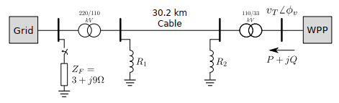
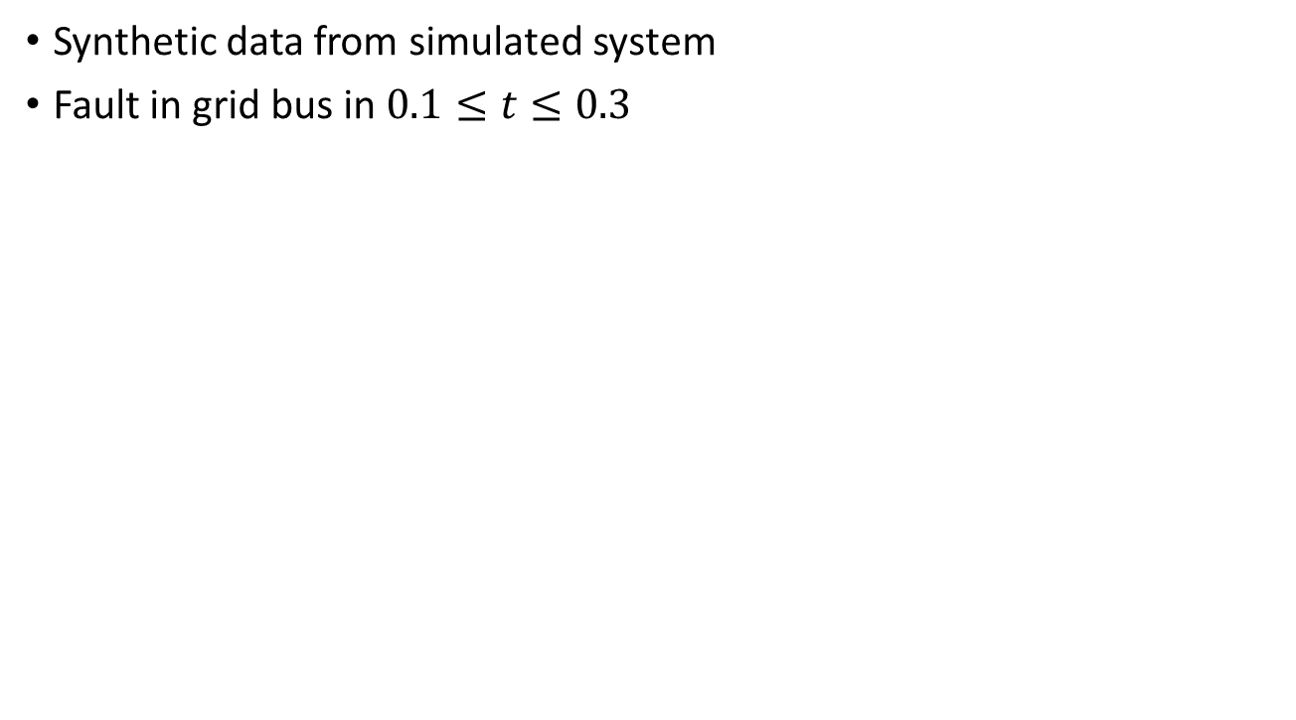
Results
Synthetic data from simulated system
Fault in grid bus in $0.1≤t≤0.3$

Slide 58
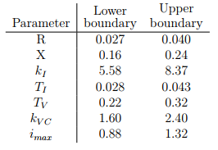
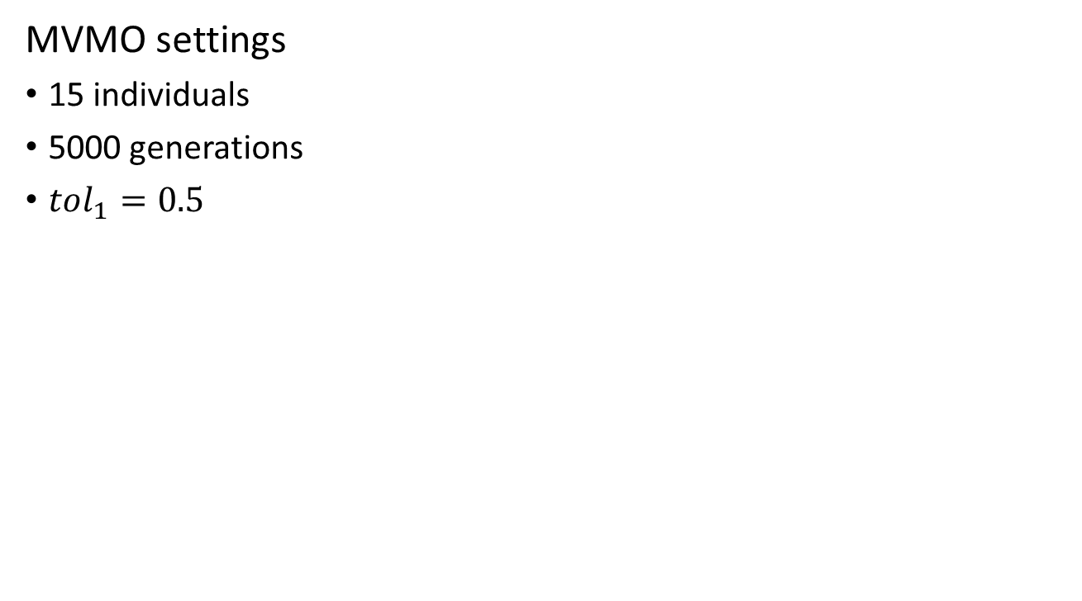
Results
MVMO settings
15 individuals
5000 generations
$tol_{1}=0.5$

Slide 59
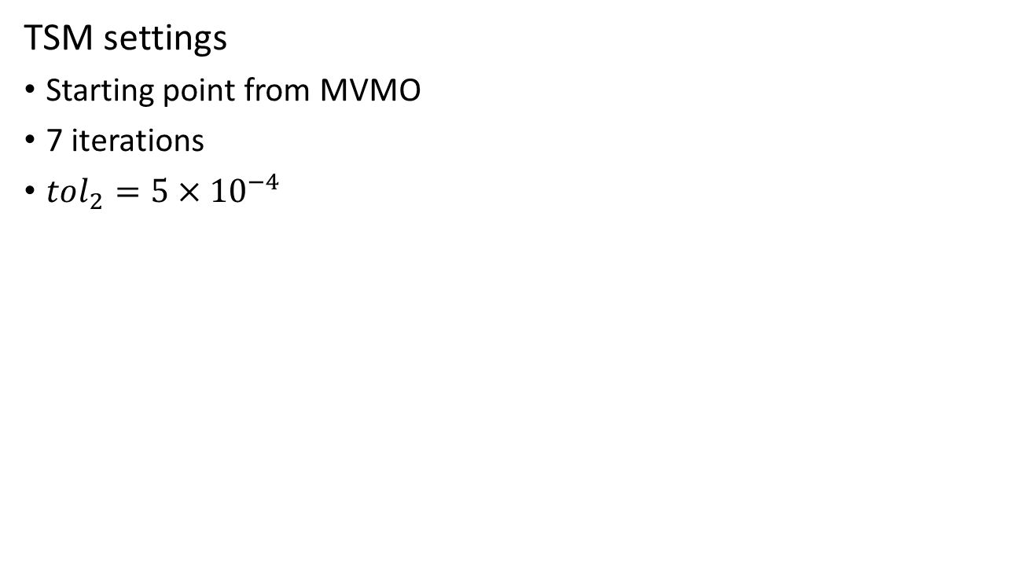
Results
TSM settings
Starting point from MVMO
7 iterations
$tol_{2}=5×{10}^{−4}$

Slide 60
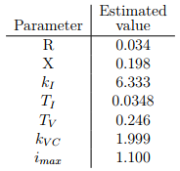
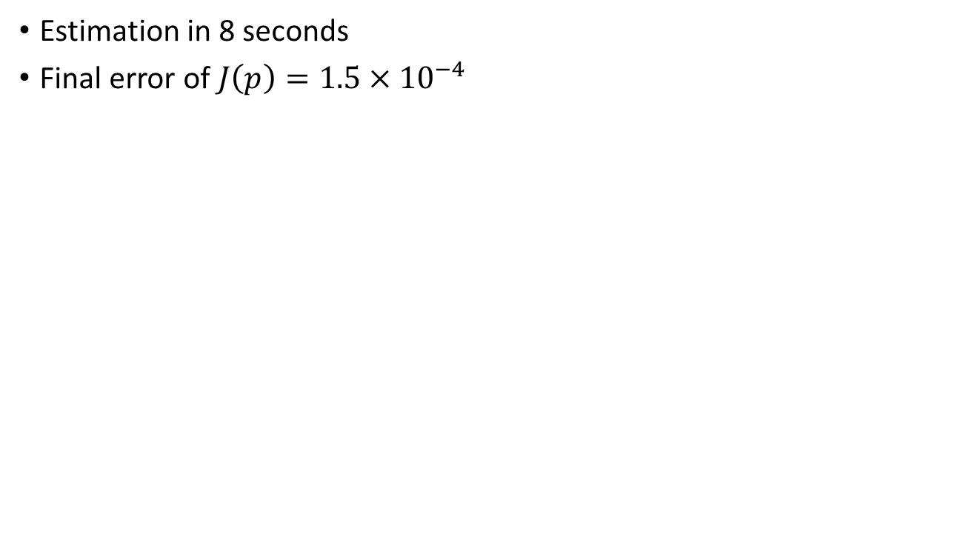
Results
Estimation in 8 seconds
Final error of $J\left(p\right)=1.5×{10}^{−4}$

Slide 61
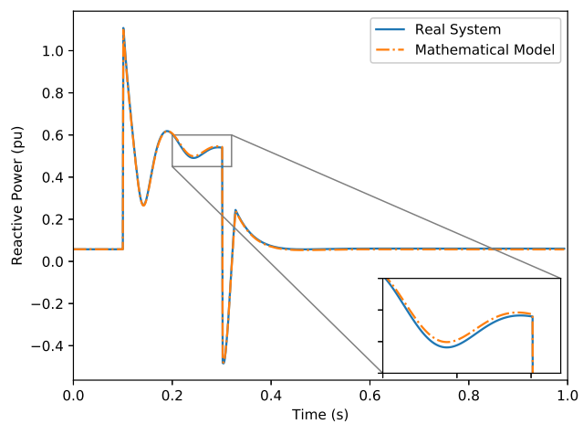
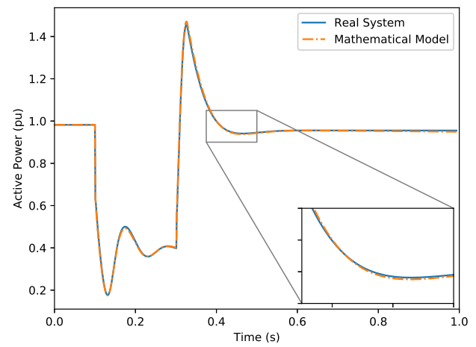
Results

Slide 62
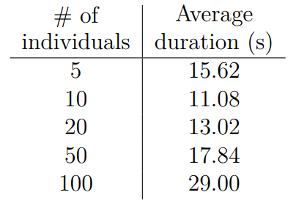

Results
Effects of population size on MVMO
5 population sizes evaluated
35 estimations for each population
$tol=0.5$

Slide 63
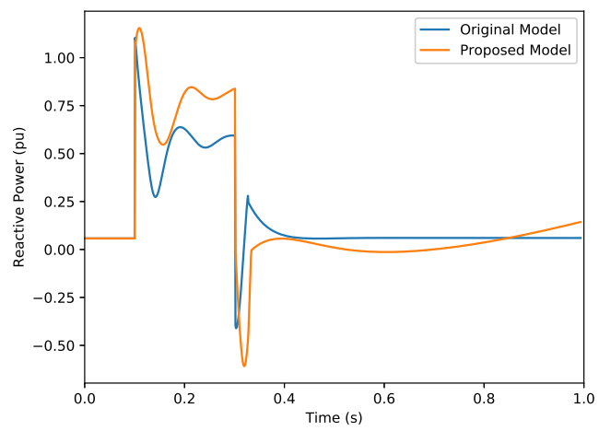
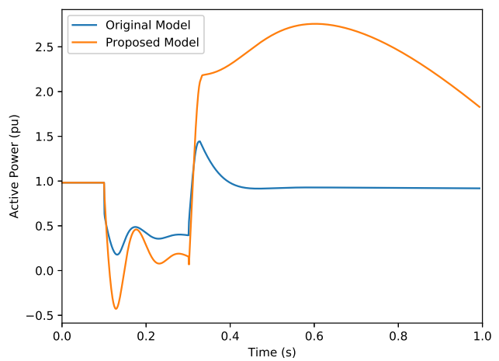
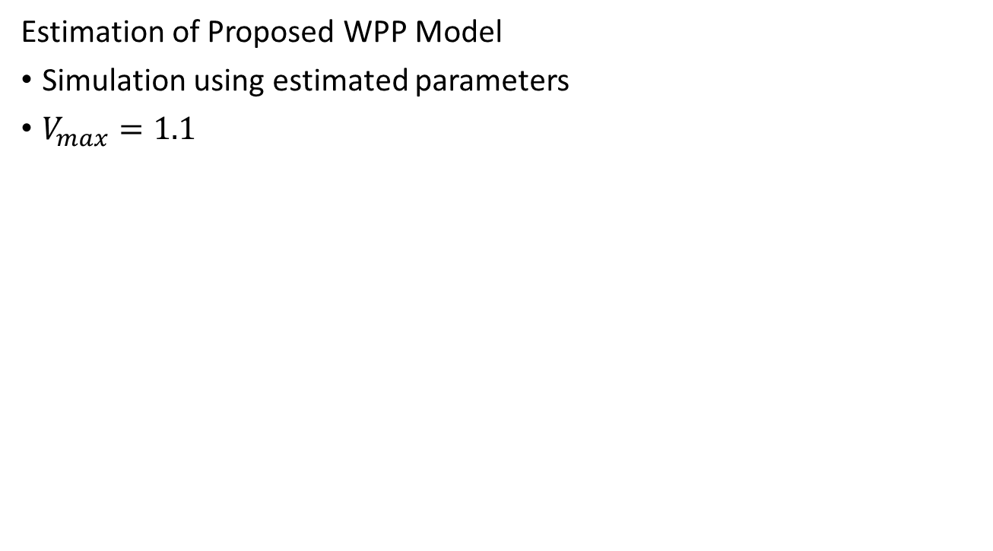
Results
Estimation of Proposed WPP Model
Simulation using estimated parameters
$V_{max}=1.1$

Slide 64
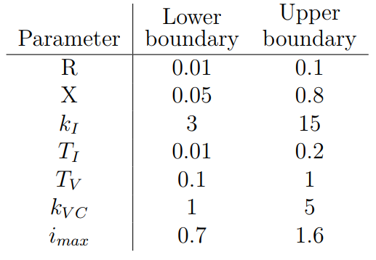
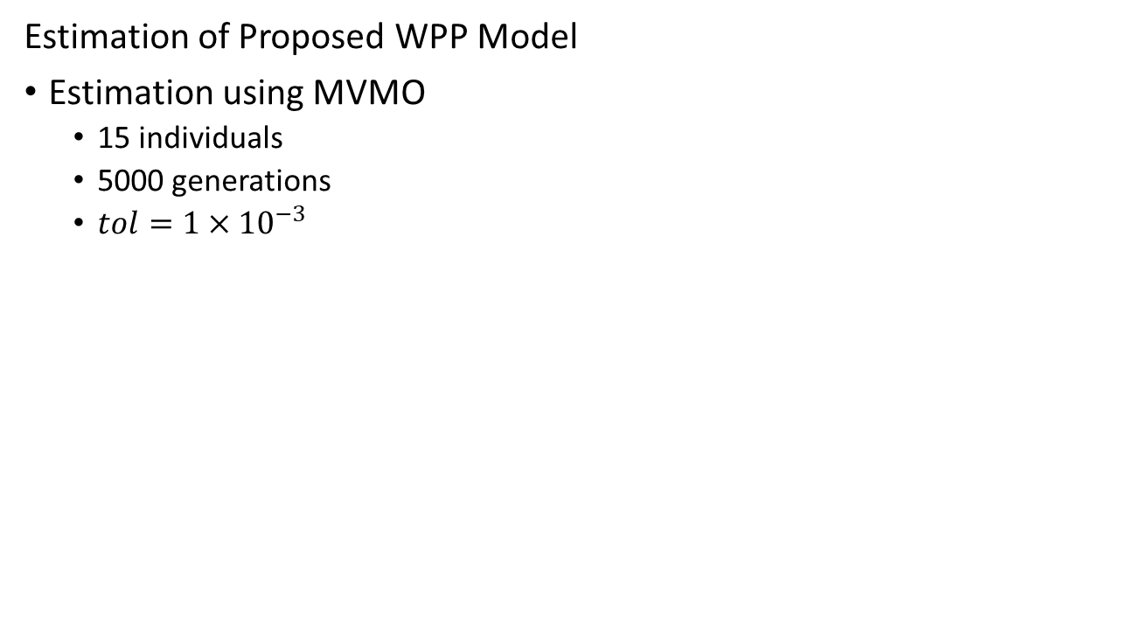
Results
Estimation of Proposed WPP Model
Estimation using MVMO
15 individuals
5000 generations
$tol=1×{10}^{−3}$

Slide 65
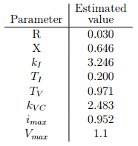
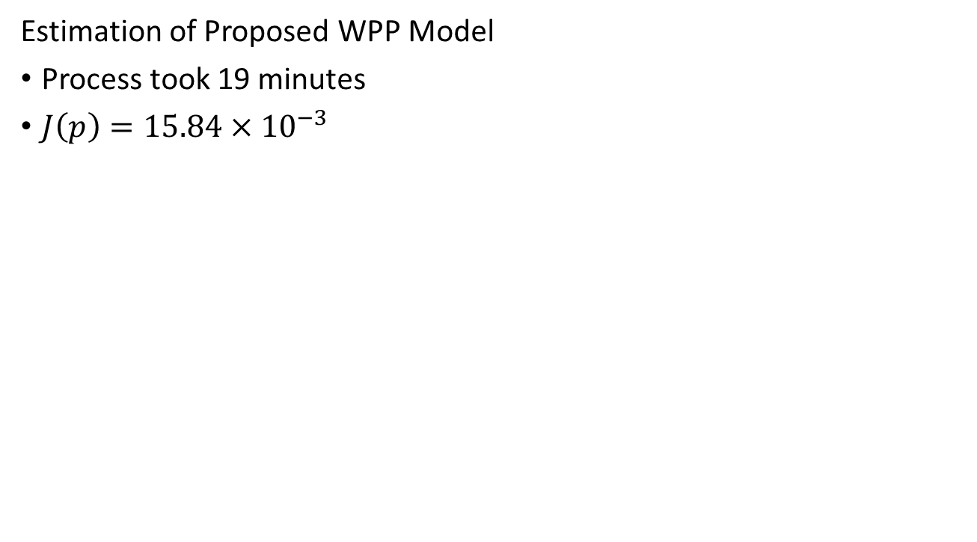
Results
Estimation of Proposed WPP Model
Process took 19 minutes
$J\left(p\right)=15.84×{10}^{−3}$

Slide 66
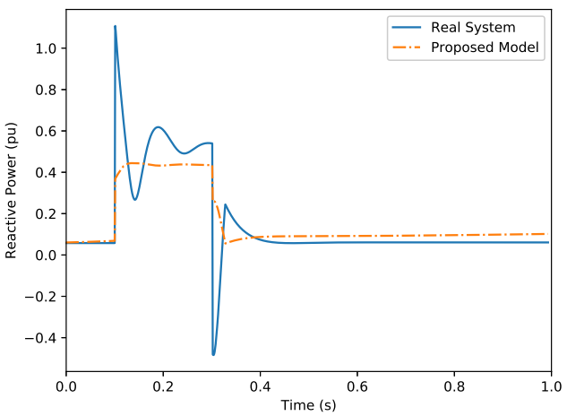
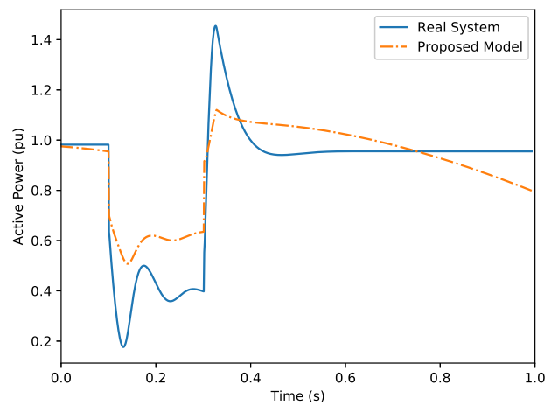
Results

Slide 67
Conclusion

Slide 68
Conclusion
Framework and Software available at GitHub
Users can download, test and contribute with project
Application of software into WPP model problem
Estimation using a hybrid approach (MVMO + TSM)
Proposal of WPP model
Avoid necessity of PMUs in the grid

Slide 69
Ongoing Research

Slide 70
Ongoing Research
Proposed WPP model
Assessment on model behavior
Hybrid Method
Implementation of other estimation methods

Slide 71
Thank you!

Slide 72
Development of Software for Parameter Estimation and its Application on Wind Power Plant Equivalent Model
Gabriel José Negrelli Gomes
Advisor: Prof. Dr. Elmer Pablo Tito Cari
São Carlos School of Engineering - EESC
University of São Paulo - USP

Slide 73
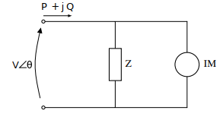
Hybrid Estimation – Load Model
Linearized Z-IM Load Model
Impedance
Third-Order Induction Motor

Slide 74

Hybrid Estimation – Load Model
Linearized Z-IM Load Model
$$\left\{\begin{aligned}\dot{∆E′}=\frac{−1}{T_{0}X′}\left[X∆E^{′}+\left(X−X^{′}\right)V_{0}\sin{δ_{0}}∆δ\right]+\frac{\left(X−X^{′}\right)\cos{δ_{0}}}{T_{0}X^{′}}∆V \\ \dot{∆δ}=\frac{\left(X−X^{′}\right)V_{0}}{T_{0}X^{′}E_{0}^{′}}\left(\frac{\sin{δ_{0}∆E^{′}}}{E_{0}^{′}}−\cos{δ_{0}}∆δ\right)+∆ω−\frac{\left(X−X^{′}\right)\sin{δ_{0}}}{T_{0}X^{′}E_{0}^{′} }∆V \\ \dot{∆ω}=−\frac{V_{0}}{MX^{′}}(\sin{δ_{0}∆E^{′}}+E_{0}^{′}\cos{δ_{0}∆δ) − \frac{E_{0}^{′}\sin{δ_{0} }}{MX′}∆V}\end{aligned}\right.$$
$$\left\{\begin{aligned}∆P=−\frac{V_{0}}{X^{′}}(\sin{δ_{0}∆E′+E_{0}^{′}\cos{δ_{0}∆δ)+\left(2G_{s}V_{0}−\frac{E_{0}^{′}\sin{δ_{0}}}{X^{′}}\right)∆V}} \\ ∆Q=−\frac{V_{0}}{X^{′}}({\cos{δ_{0}}∆E^{′}+E_{0}^{′}\sin{δ_{0}∆δ)+\left(2B_{s}V_{0}+\frac{2V_{0}−E_{0}^{′}\cos{δ_{0}}}{X}\right)∆V}}\end{aligned}\right.$$

Slide 75

Hybrid Estimation – Load Model
Linearized Z-IM Load Model
$$x={\left[∆E′,∆δ,∆ω \right]}^{T}$$
$$y={\left[∆P,∆Q\right]}^{T}$$
$$u=∆V$$
$$p={\left[X, X^{′},T_{0},M,G_{s},B_{s}{,E}_{0}^{′},δ_{0}\right]}^{T}$$

Slide 76


Hybrid Estimation – Load Model
Linearized Z-IM Load Model
$tol=0.5×{10}^{−4}$
5 individuals

Slide 77

MVMO Process

Slide 78

MVMO Process

